Slide 1
Introduction to Computing
for the Social Sciences
Session 1 - Introduction
David Garcia
Winter Semester 2024-25

Slide 2




About me
B.Sc. Computer Science – Universidad Autónoma de Madrid
M.Sc. Computer Science – ETH Zurich
Theory of computation track
Doctorate at ETH Zurich: Department of Management, Technology and Economics
Habilitation at ETH Zurich – Now Privatdozent teaching Social Data Science
Group leader at the Medical University of Vienna
Faculty member at the Complexity Science Hub Vienna
Professor for Computational Behavioral and Social Sciences Graz University of Technology
Since 1.10.2022: Professor for Social and Behavioral Data Science – University of Konstanz Leading the Social Data Science lab: https://www.polver.uni-konstanz.de/social-data-science-lab/

Slide 3
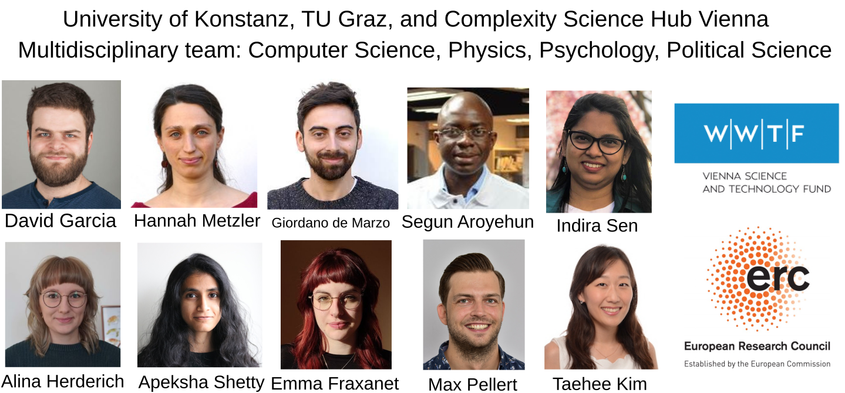
My team in Vienna, Graz and Konstanz

Slide 4
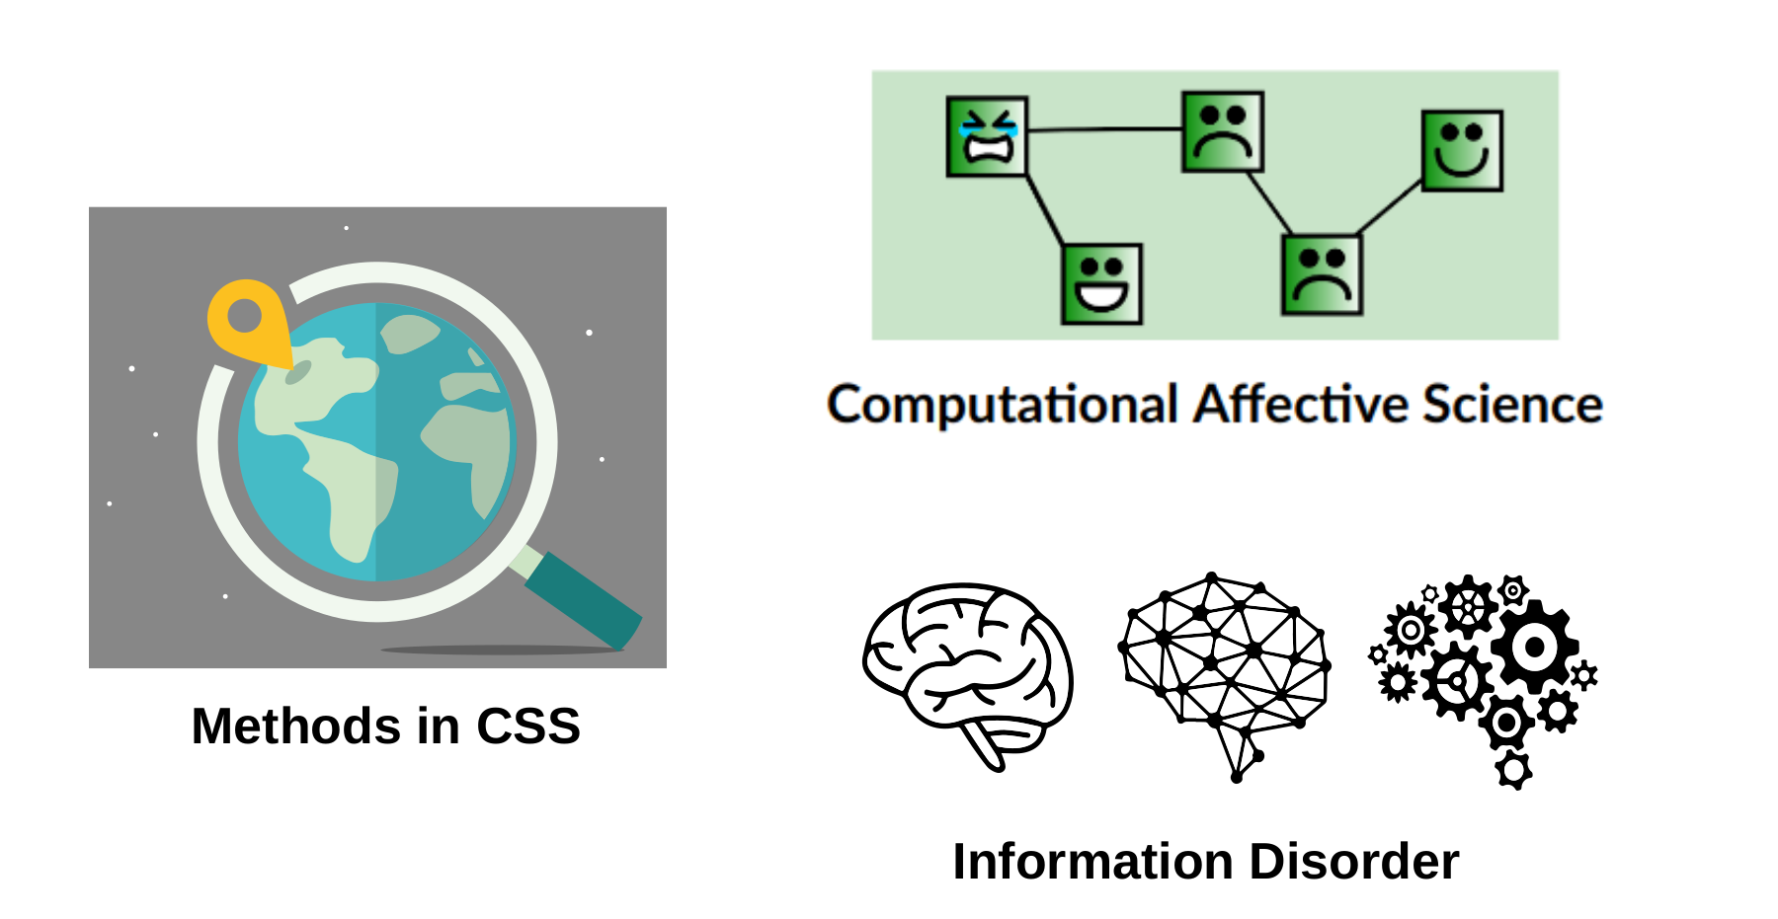
My Research Topics

Slide 5


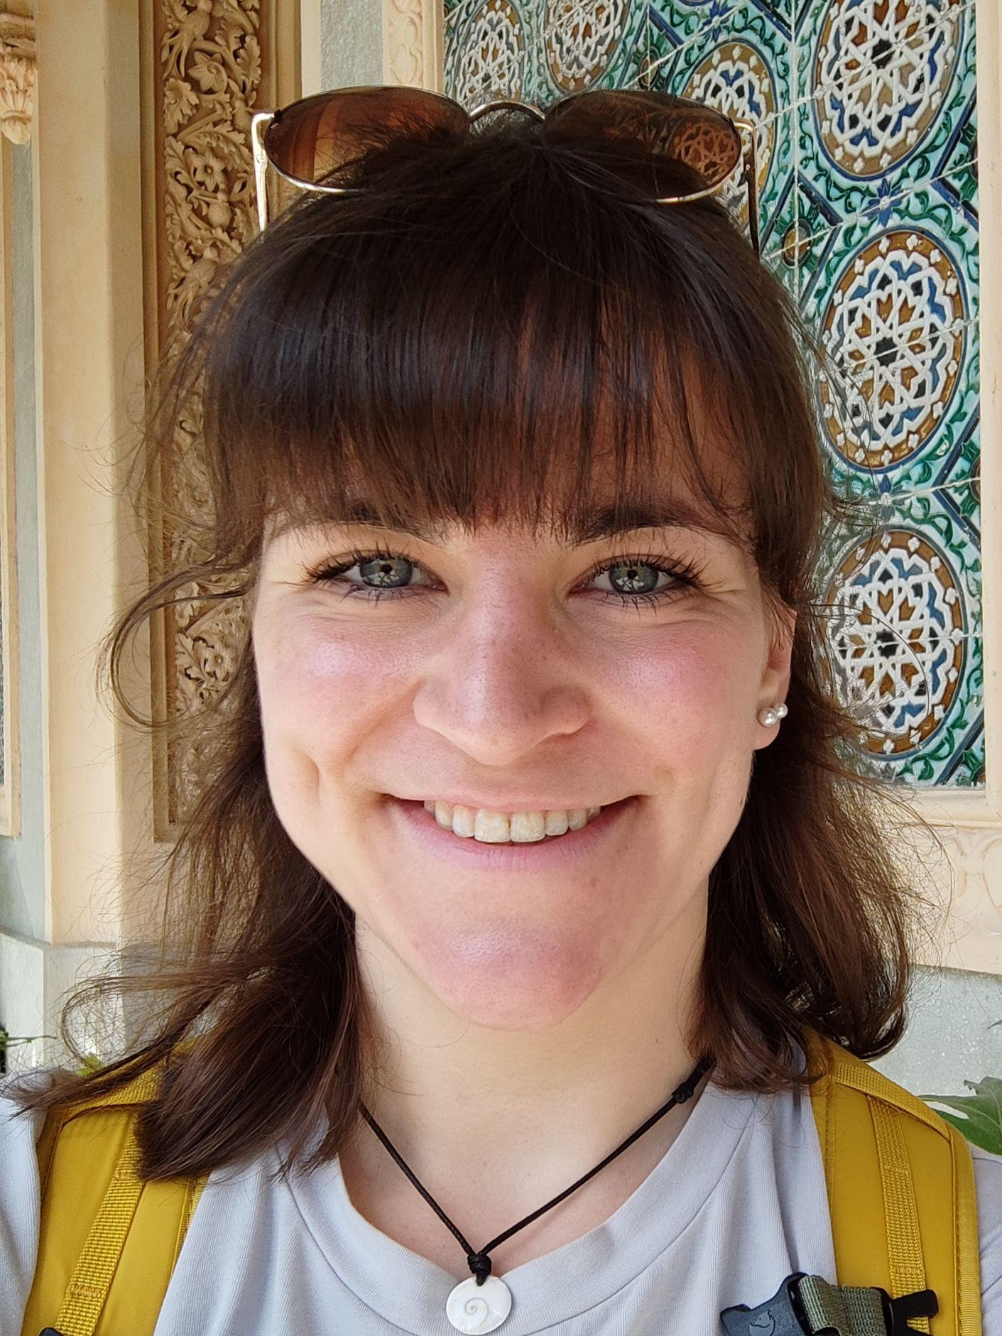
The ICSS Team
Lectures:
Prof. Dr. David Garcia Becerra email: david.garcia@uni-konstanz.de office: D338 consultation hours: Mondays 15:30-16:30, book on Ilias
In-person tutors:
Liane Strauch liane.strauch@uni-konstanz.de
Claire Jordan claire.jordan@uni-konstanz.de
Elena Solar elena.solar@uni-konstanz.de
Online support for assignments (through Discord):
Andri Rutschmann andri.rutschmann@uni-konstanz.de

Slide 6
Outline
Course Motivations and Objectives
Course Overview
Formalities
A Brief Introduction to Computer Science
Literature

Slide 7

The Digital Society
More and more of our actions happen
through digital technologies, e.g.:
Searching for a job online
Talking with a family member over the phone
Sharing open source code
Posting a video on a social networking site
Paying at the supermarket with a credit card
Chatting with your boss on a company instant messenger

Slide 8
The Digital Transformation
The growth in adoption and evolution of these technologies is the digital
transformation of society, which has some consequences:
Datafication: Digital technologies generate data traces that can persist and be analyzed
How individuals interact with digital technologies is based on the code of
software running on them. The design of that code is based on algorithms
that describe the rules of how the technology operates
Digital technologies might use data produce by humans in their algorithms, for example through machine learning models to personalize content or make predictions

Slide 9
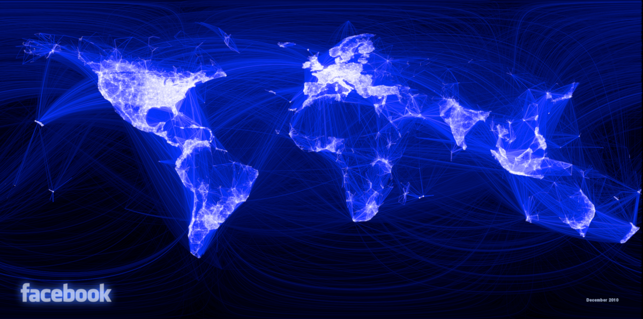
Digital trace data
Facebook: Visualizing Friendships

Slide 10
Motivation I: the Data revolution
Big Data: Observing large amounts of humans across demographics Example: Large-scale sentiment analysis for opinion estimation
Fast Data: Quantifying aspects of human behavior in real time Example: Earthquake detection with social media
Long Data: Retrieving longitudinal data and at various timescales Example: Analyzing cultural trends with Google books
Deep Data: Gathering persistent information on individuals Example: Estimating personality with Facebook likes
Mixed Data: Combining heterogeneous data sources and unstructured data Example: Data mashups in algorithmic trading
Strange Data: Locating small subcommunities or deviant behavior Example: Mass shooting fans on Twitter or rare disease discussion forums

Slide 11
Motivation II: the Computational revolution
Computational methods are critically important to handle and analyze new social data
automation and scalability: we cannot process everything by hand
robustness: analysis changing assumptions or parameters
reproducibility: code for anyone to build and replicate
BUT lack of fundamental understanding of the “tools” we use
often only a working knowledge of high-level software programs e.g. Excel, SPSS, STATA
complex research problems require more advanced computational skills
automate data retrieval and handling
design efficient algorithms and run them in computational infrastructure
develop software that implement specific methods or solutions

Slide 12
Motivation III: Challenges in Data Science
Understanding computation is a requirement to understand current issues in the digital society, technology, and social science research
Platform biases: The design of platforms and their algorithms can affect the behavior we observe. Some platforms have non-human actors (e.g. bots) that affect the data.
Data gatekeepers: Not everyone can access the same data. Some research might be impossible to reproduce.
Performative behavior: Talking online is not the same than offline. We have to consider what is the purpose of the people involved and if that distorts their behavior.
Representativity issues: Not everyone leaves digital traces and measurement methods or predictive models can have biases that lead to discriminatory outcomes.
Privacy and ethics: data is people - privacy expectations and downstream consequences of technology are new ethical issues.
The data deluge: Too much data enables black-box predictions that can be useful but limit our understanding.

Slide 13
Goals of the Course
Overarching goal: being able to solve problems computationally
Understand “basic” computer science concepts
information coding, storage, and processing
Learn these concepts “in context”
what do we need them for?
how do they help in our daily research?
recognize and use established best practices from computer science
Goals are set to enable:
effectively bridge between social science research and computational methods
not an expert but computer science “fluent”
ability to start follow-up courses in computer science to gain a deeper knowledge

Slide 14
Learning objectives
Appreciate, understand and use ideas at the core of computer science and programming
Demonstrate familiarity with major algorithms and data structures
Use computational techniques for solving problems in the social sciences
Have familiarity with Python programming language for simple computational tasks

Slide 15
Course Overview
Course Motivations and Objectives
Course Overview
Formalities
A Brief Introduction to Computer Science
Literature

Slide 16
Overview of the Course
Fundamental principles of Computer Science & basic programming concepts
Topics covered:
principles of information coding
computer systems & information storage
data types, data structures & algorithms
different programming paradigms
basic database and parallel programming concepts
Format:
concepts and theory are taught in the lectures
assignments rely wherever possible on real-world examples and data
teaching language is Python
Practice and self-learning are essential in computing. Not only concepts and theories are important, you have to be able to use them.

Slide 17
Course Outline
Session 1: Introduction
Session 2: Information Coding
Session 3: Data Structures
Session 4: Programming
Session 5: Algorithms
Session 6: Recursion
Session 7: Sorting Algorithms
Session 8: Time Complexity
Session 9: Formal Languages and Automata
Session 10: Turing Machines and Complexity Classes
Session 11: Databases
Session 12: Parallel Programming
Session 13: Social Science Applications
Session 14: Exam Review

Slide 18
Formalities
Course Motivations and Objectives
Course Overview
Formalities
A Brief Introduction to Computer Science
Literature

Slide 19
Structure
Lectures + theory exercises + tutorials
90 min lecture (David)
Wednesdays 10:00 – 11:30 in C358
90 min theory exercises (David)
Wednesdays 11:45 - 13:15 in C358
90 min tutorial sessions (Claire, Andri, Liane)
Wednesdays 15:15 – 16:45 in C424
Thursdays 15:15 – 16:45 in D432
Each tutorial covers skills towards the four assignments of the course
No hard assignment to groups - please try to self-organize and balance
More information about tutorial workflow in first tutorial session

Slide 20
Course Grading
The course assessment is based on three parts:
Mandatory assignments
Short pen-and-paper coding exam
Final written exam
To qualify to attend to the final written exam, a student has to pass all:
all four mandatory assignments
the short pen-and-paper coding exam
The final course grade is determined by the final written exam with additional bonus points for excellent assignments.

Slide 21
Mandatory assignments
The course has four mandatory programming assignments during the semester
To take part in the final exam, a student has to pass each of the four assignments:
i.e. to get at least 50% of the points in each assignment Do not leave assignments to the last minute!
Students can achieve the grade “excellent” in an assignment by getting more than 90% of the points.
Bonus points:
two or three assignments with “excellent” grade: bonus 0.3 in final grade
all four assignments with “excellent” grade: bonus 0.6 in final grade
Assignments may have bonus points to help achieving an excellent grade but not to pass the assignment.

Slide 22
Short pen-and-paper coding exam
A pen-and-paper coding exam with short questions about programming.
Special focus on code understanding and output interpretation
Not an exam of coding on paper
Easy to pass if you did the assignments yourself
This exam is only graded with pass/fail and will take place once per year at the end of the lectures period: Feb 5th, 2025
It is necessary to pass the coding exam to be allowed to go to the final written exam.
Grades will be announced soon after the exam (expected Feb 6th)
If you fail this exam, you will have to do ICSS next year

Slide 23
Final written exam
The final exam will take 90 minutes and its grade will be the final grade of the course. On top of this final grade, the bonuses of assignments will be applied.
Expected dates (tentative): Feb 17th and March 26th (repetition)
Closed book, no calculators allowed
Pen-and-paper exercises are examples of written exam exercises. Do try them before the solutions session and come to show your solutions.
Last lecture will be an exam review based on an example
Learning in Computer Science means generalizing. To learn more, do other exercises, check reading materials, and ask for more in our sessions.
For example, you have to be able to approach a computational problem we have never seen in class and to understand the properties of the solution.

Slide 24

A note on ChatGPT
Be careful using AI coding tools like ChatGPT!
Not forbidden but it is easy to misuse them
ChatGPT solutions are code that runs but often does not do the task you want
Learning to code with ChatGPT is like learning a language with DeepL: you won’t learn
If you overuse ChatGPT or copy assignment solutions form colleagues, you will fail the coding exam
Assignment solutions suspected to be copied from ChatGPT or other students will be sent to the plagiarism office
In further courses in the SEDS program use LLMs for text analysis and other tasks, now better focus on your own code

Slide 25
Materials: ZEuS and Google slides
The full course syllabus is available on ZEuS:
http://zeus.uni-konstanz.de
dates and rooms
Basic information including course and examination format etc.
Make sure you are enrolled both to lecture and tutorials
Lecture slides are hosted on Google slides
Every week, a link to the slides will be posted on Ilias before the lecture
Write comments with questions, we will discuss them in the following session
You can export the slides to pdf or ppt if you want

Slide 26
Course resources
Website for the course on Ilias
please join the course Introduction to Computing for the Social Sciences
https://ilias.uni-konstanz.de/goto_ILIASKONSTANZ_crs_1794519.html
Links to google slides will be posted there
Pen-and-paper exercise sheets will be posted weekly
Assignment solutions and related files are distributed through github (More info in the tutorials). You hand in your solutions through github classroom
For questions about the tutorials, online support about assignments, and discussions with your classmates, Discord :https://discord.gg/uynmm6tAxR
Questions for me:
If useful for other students: on Google slides or during lectures
If private: request an appointment for consultation hours (Ilias)

Slide 27
A Brief Introduction to Computer Science
Course Motivations and Objectives
Course Overview
Formalities
A Brief Introduction to Computer Science
Literature

Slide 28
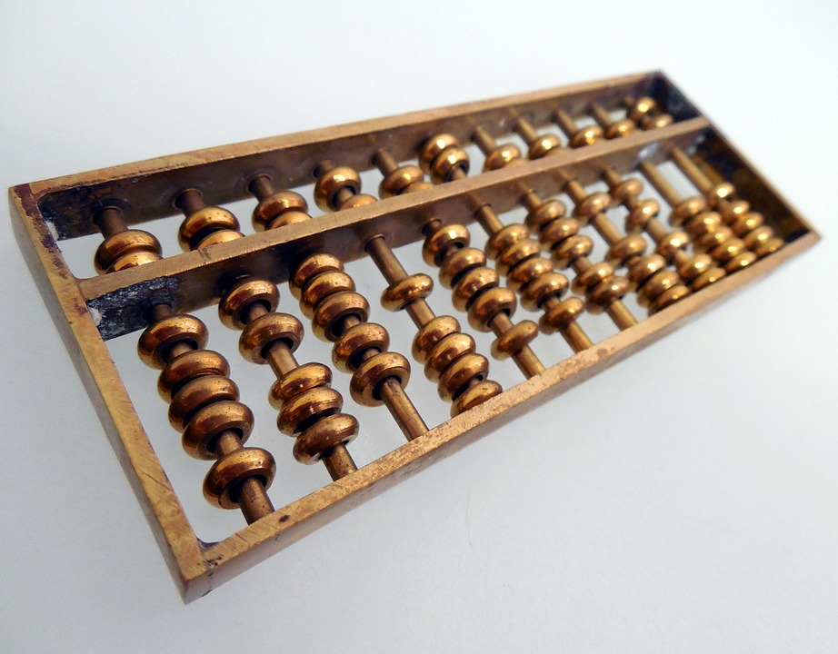
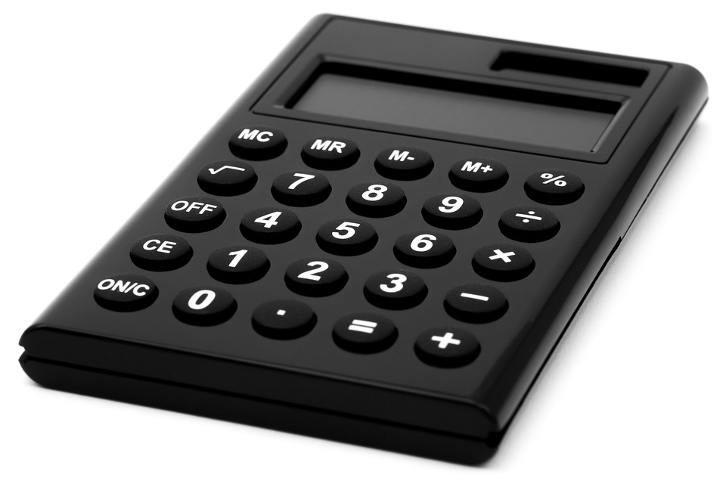
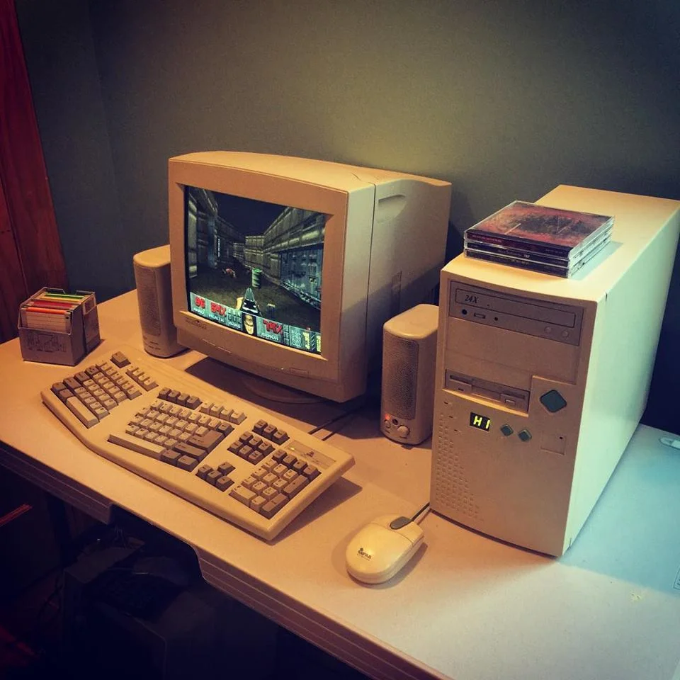
What is a Computer?
What is a computer?
“A machine that stores and manipulates information under the control of a changeable program” (Zelle, 2004)
stores and manipulates information but not a machine (not automated)
automatically stores and manipulates information but not programmable
Today: Personal computers, servers, smartphones, fridges, photo cameras, watches, etc

Slide 29
What is Computer Science?
What is computer science?
scientific and practical approach to computation
enable collection, representation, processing, storage and access to information
study of theory of computation, algorithmic processes, and design of computational machines
“Computer science is no more about computers than astronomy is about telescopes.” (Attributed to Edsger W. Dijkstra)
Questions in computer science
What can be computed? (Finding what is computable)
How can we solve a problem with computation? (Designing algorithms, i.e. recipes to solve problems)

Slide 30
What is an algorithm?
An algorithm is a self-contained step-by-step set of operations to solve a given problem. Algorithms perform calculation, data processing, and/or automated reasoning tasks.
Procedure SELECTION-SORT(A, n)
Inputs:
A: an array
n: the number of elements in A to sort
Result: The elements of A are sorted into nondecreasing order
For i = 1 to n - 1:
smallest ← i
For j = i + 1 to n:
If A[j] < A[smallest], then smallest ← j.
Swap A[i] with A[smallest]
Example: SelectionSort
Problem: Sort a list of elements
The algorithm is the set of steb-by-step operations to solve the problem
Idea: find the smallest and swap it with the first one not sorted yet

Slide 31
What is an algorithm?
Python Code:
def selection_sort(A, n): for i in range(n-1): smallest = i for j in range(i+1, n): if A[j] < A[smallest]: smallest = j # Swap temp = A[i] A[i] = A[smallest] A[smallest] = temp return A
Pseudocode:
Procedure SELECTION-SORT(A, n)
Inputs:
A: an array
n: the number of elements in A to sort
Result: The elements of A are sorted into nondecreasing order
For i = 1 to n - 1:
smallest ← i
For j = i + 1 to n:
If A[j] < A[smallest], then smallest ← j.
Swap A[i] with A[smallest]

Slide 32
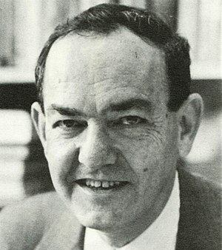
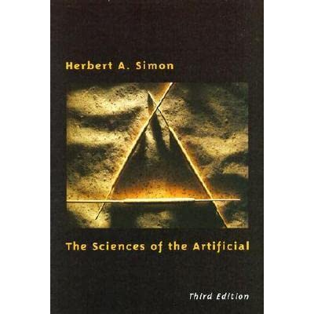
The Sciences of the Artificial
Herbert Simon (1916 – 2001): Political scientist with great influence in Economics (Nobel Prize) and Computer Science
Artificial Sciences versus Natural Sciences
Artificial sciences study what humans create
Artificial sciences are not only descriptive but also prescriptive: they try to find what we should do, not just how things are
E.g. economists look for a tax incentive to drive innovation
E.g. sociologists look for a policy to reduce gender inequality
E.g. computer scientists look for the program that allows a robot to find its way in a maze, or to make a decision about who to interview for a job, who to give parole, or where to place refugees in a country
Prescriptive sciences study phenomena with a purpose
Computation has a purpose, usually posed as solving a problem
1) designing and testing methods
2) methodology: the systematic study of methods and their properties

Slide 33
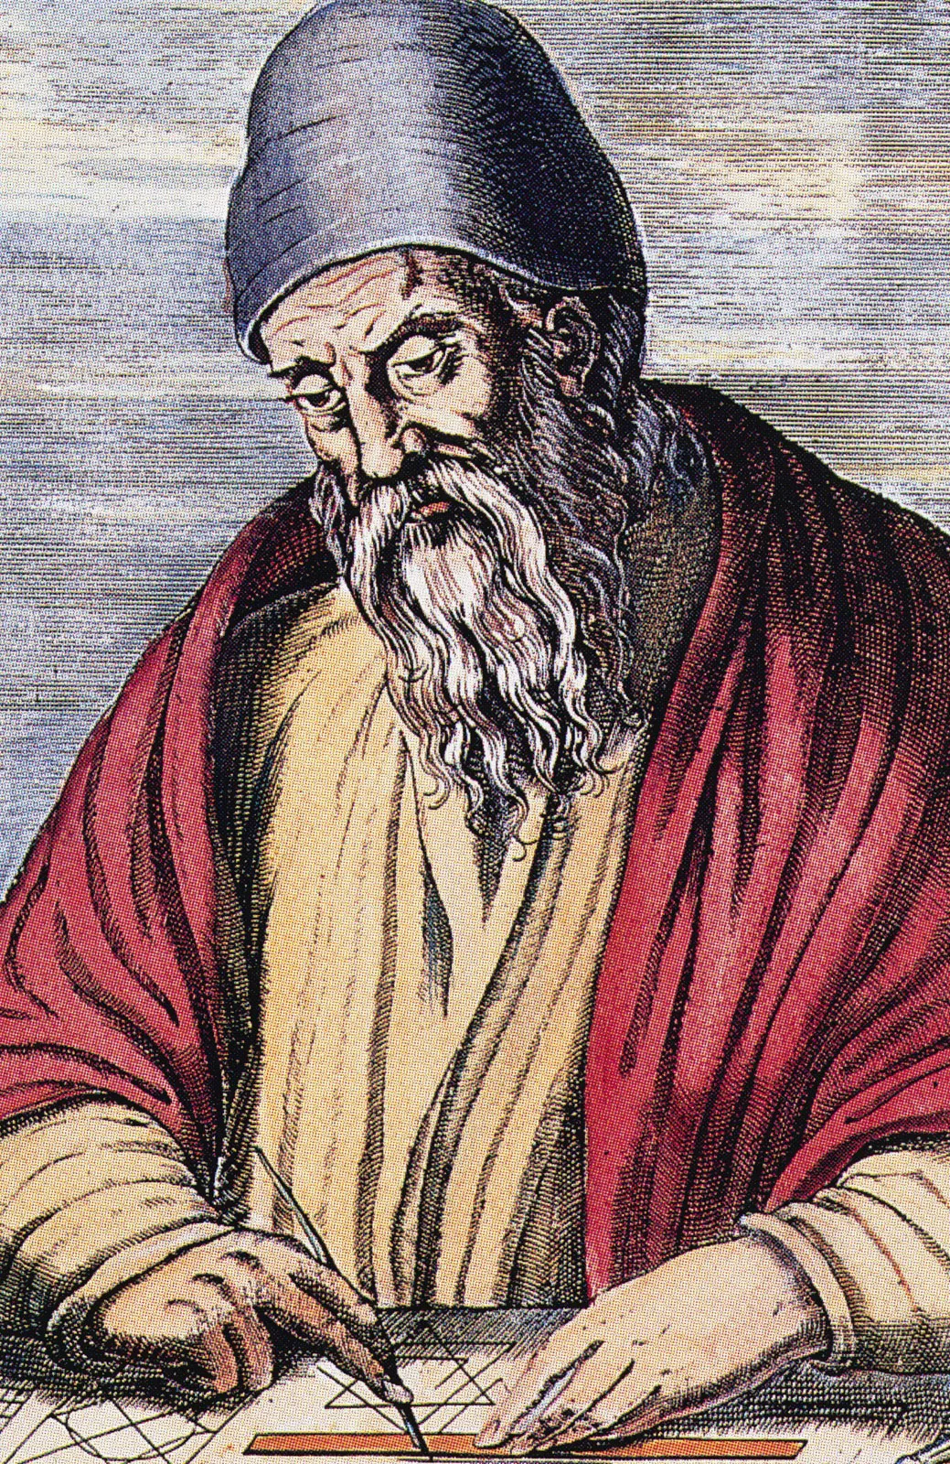
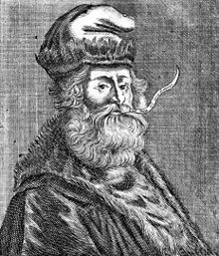
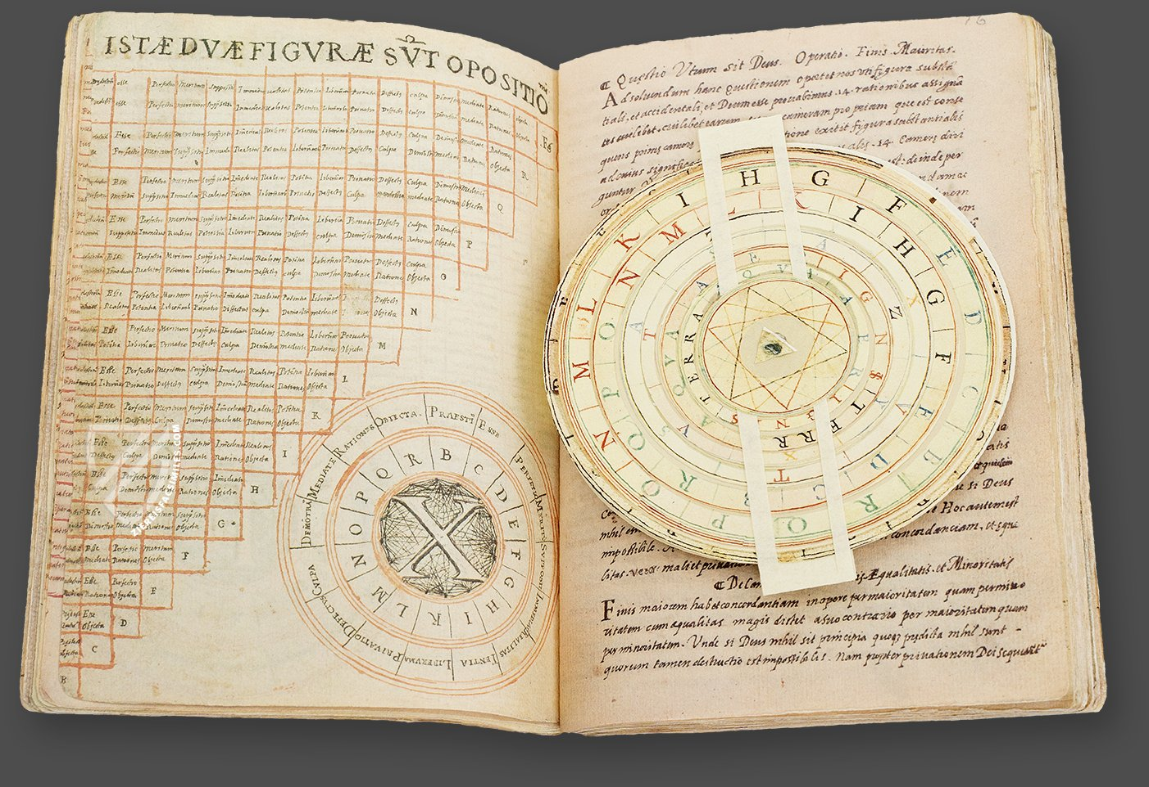
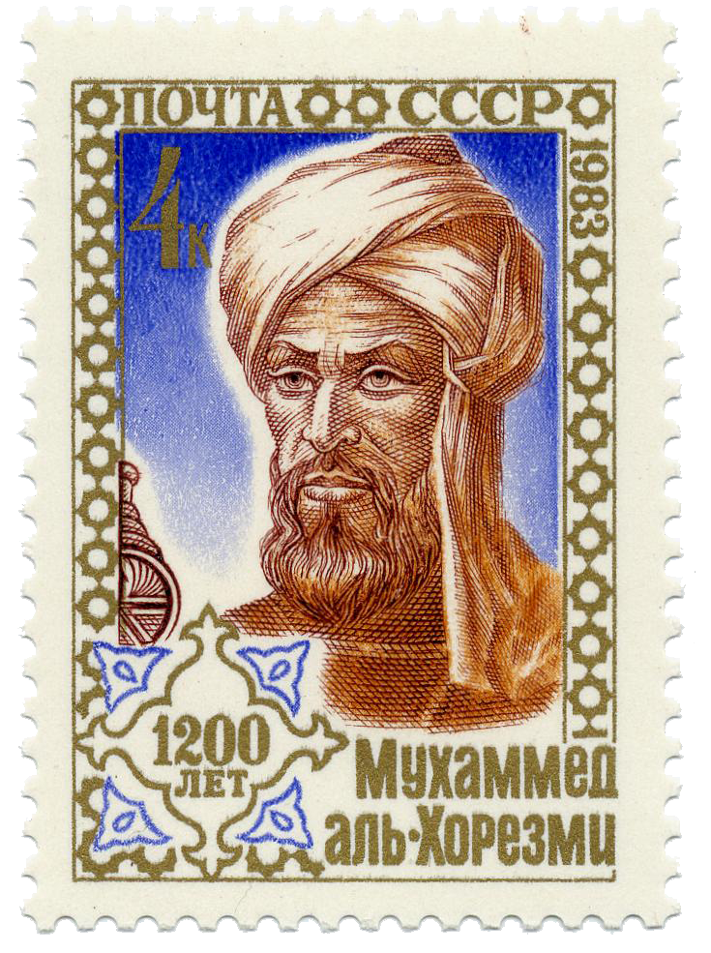
Antecessors of Computer Science
~ 300 B.C.
Euclidian algorithm
820 A.D.
Al-Khwarizmi lays foundation for “algorithms”
1305
Ramon Llull’s mechanical logic

Slide 34
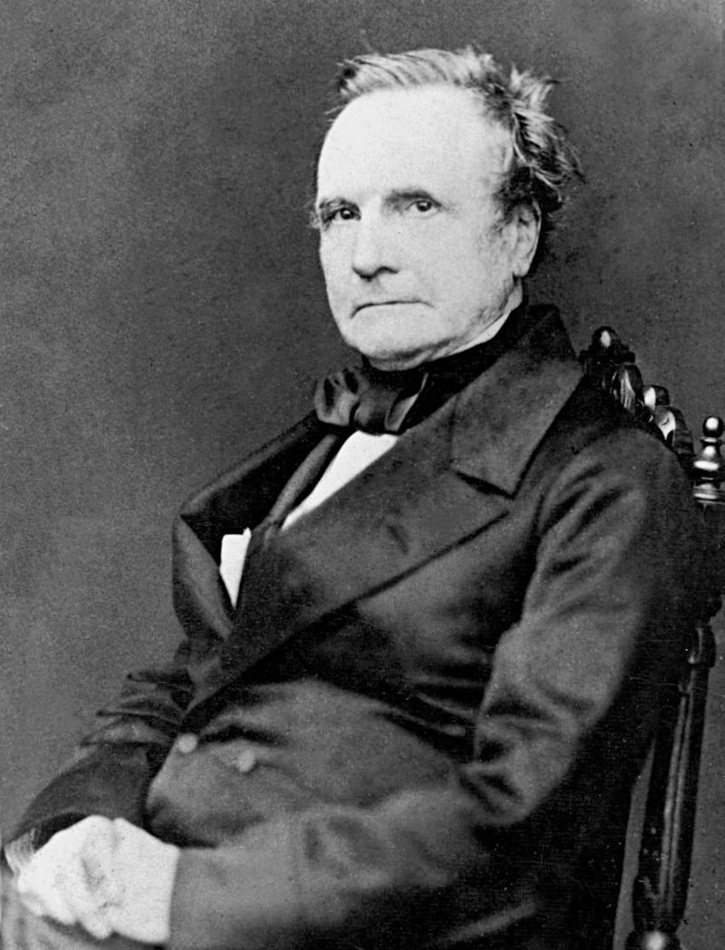
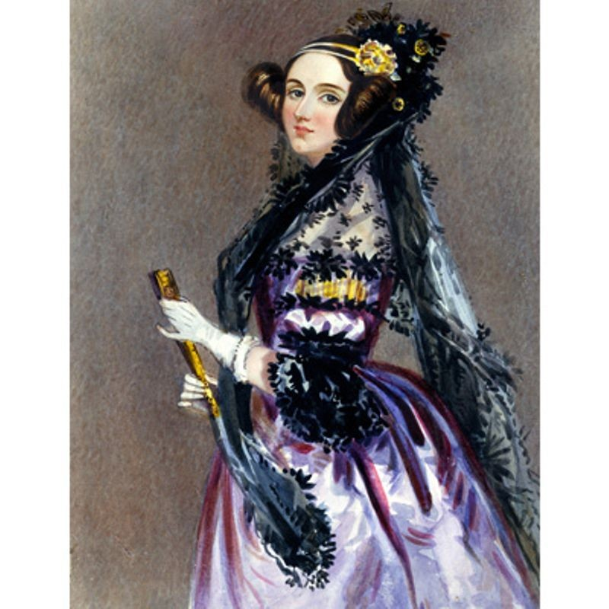
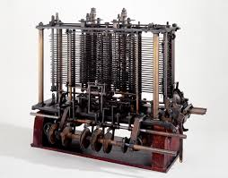
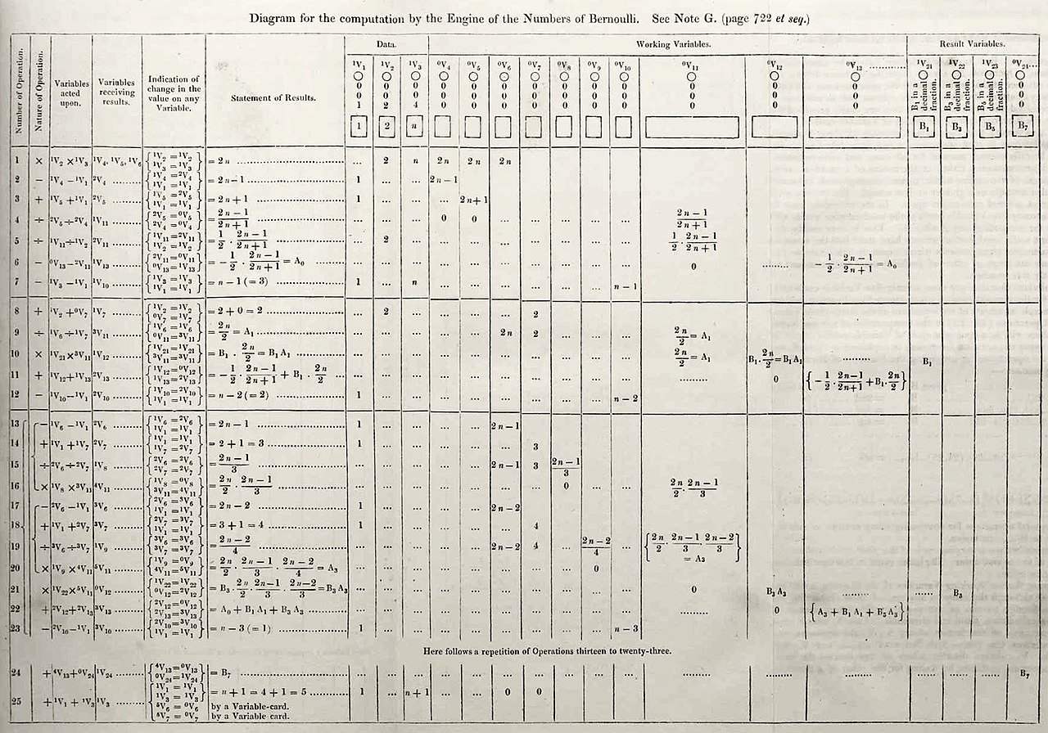
The First Concept of Computers
Charles Babbage’s analytical engine
Ada Lovelace’s first computer program
1820s

Slide 35
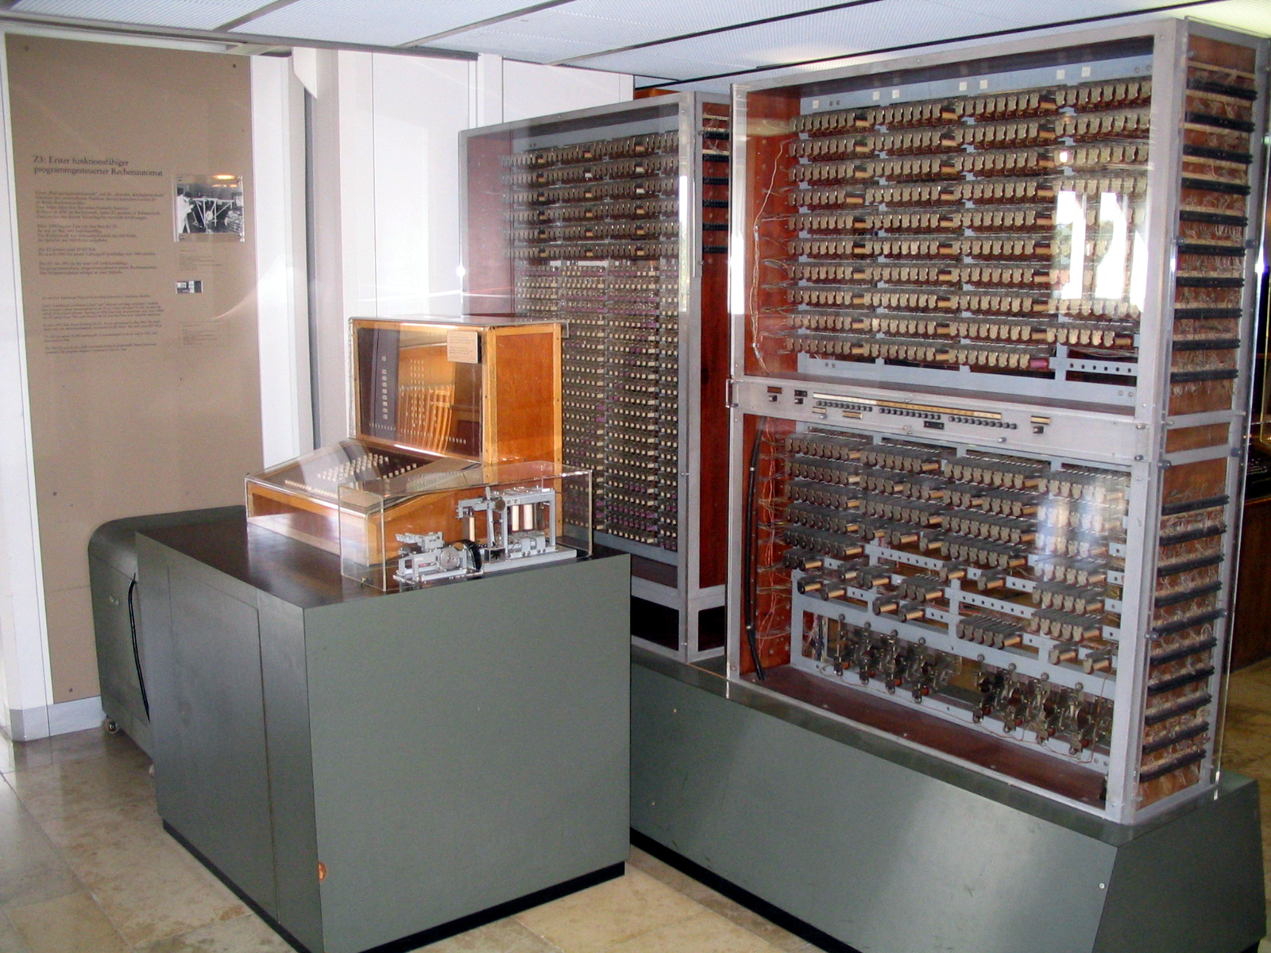
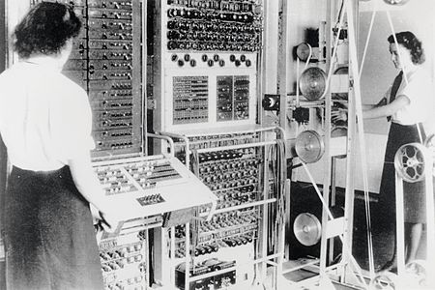
The First Real Computers
1941
Konrad Zuse’s first functioning computer Z3
1944
Colossus Mark 2 computer cracks Enigma code

Slide 36
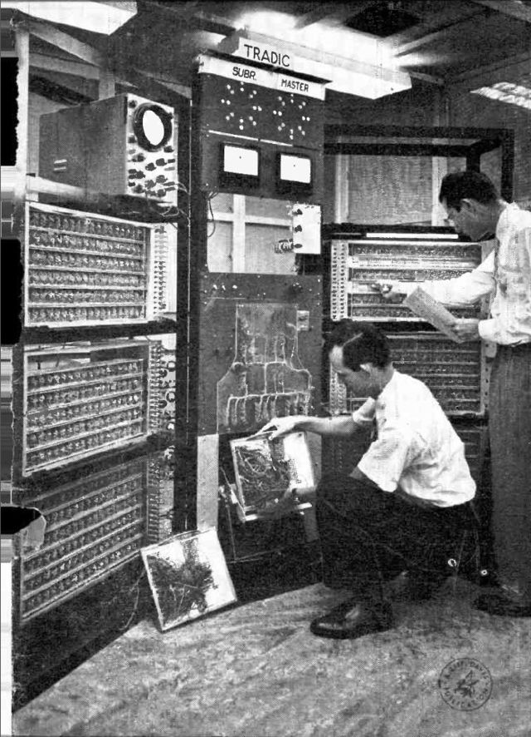
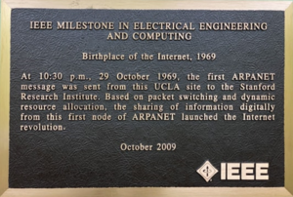
Computing Goes Industrial
1954
First transistor computer TRADIC at Bell Labs
1969
First message send via the ARPANET

Slide 37
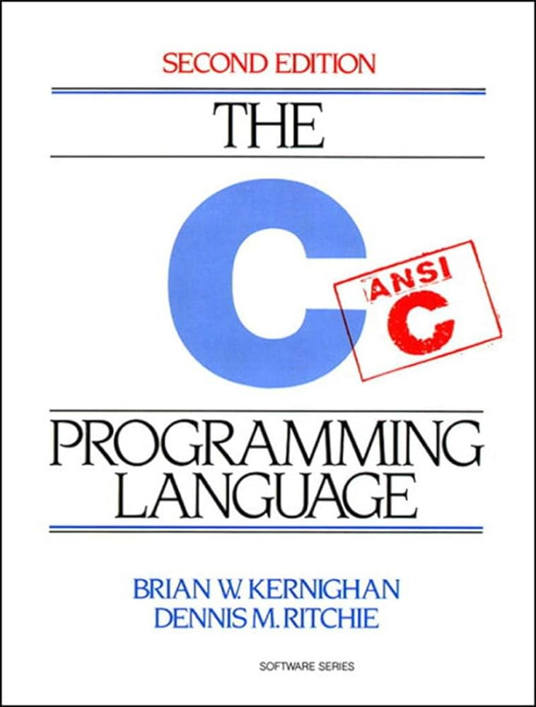
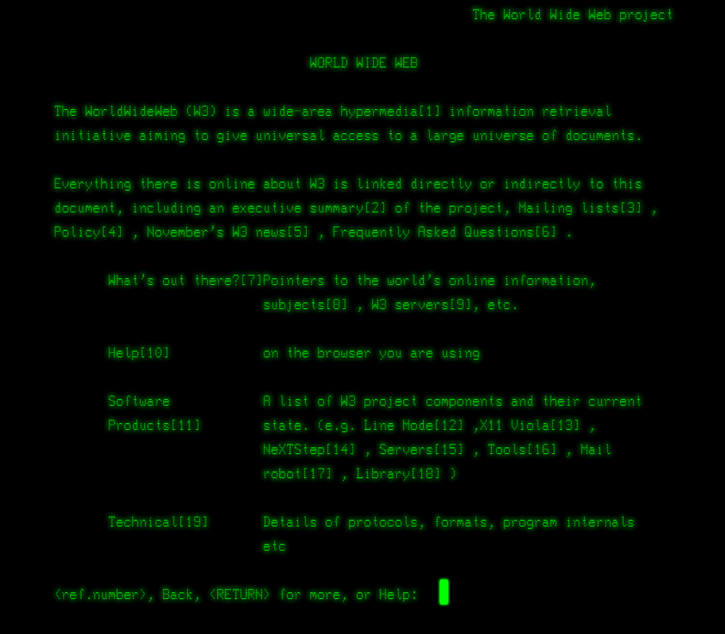
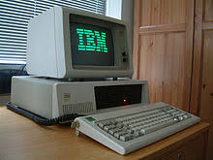
The PC era
1972
Introduction of the C programming language
1980
IBM PC delivered
1990 -
Development of the WWW at CERN, Switzerland

Slide 38
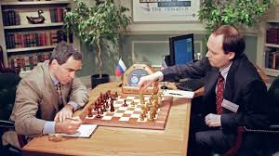
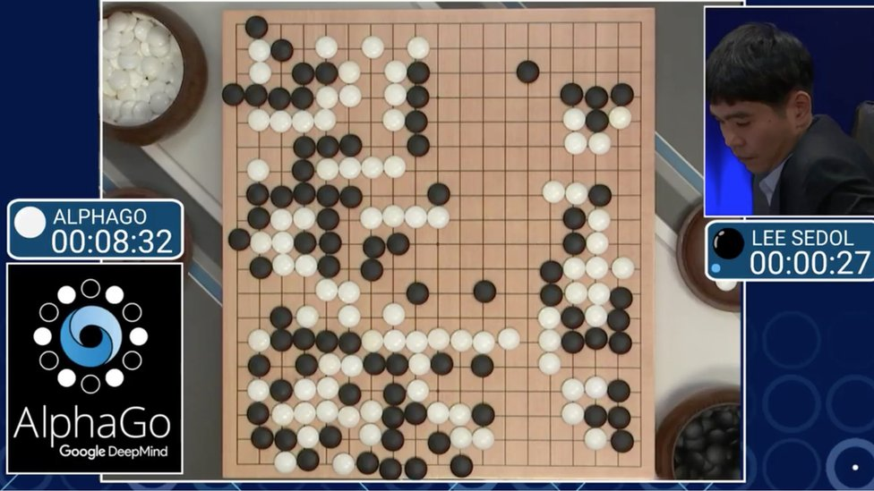

The AI era
1997
Deep Blue beats Gary Kasparov
2016
AlphaGo beats Lee Sedol
2022
AI becomes popular with ChatGPT

Slide 39
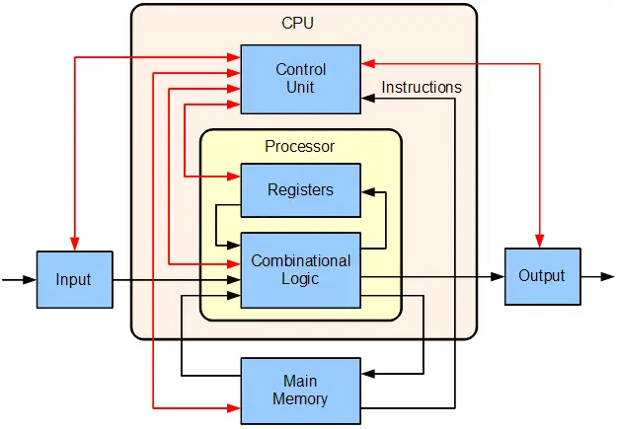
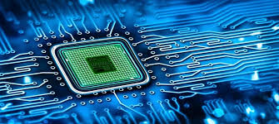
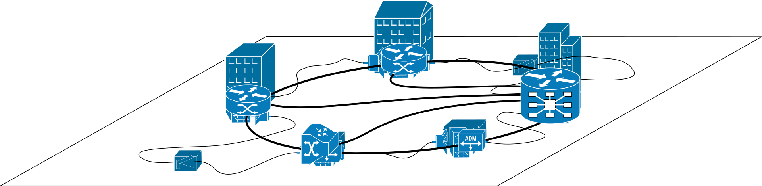
Subfields of Computer Science
Computer Engineering
Microprocessor technology
Computer architecture
Communication between machines

Slide 40
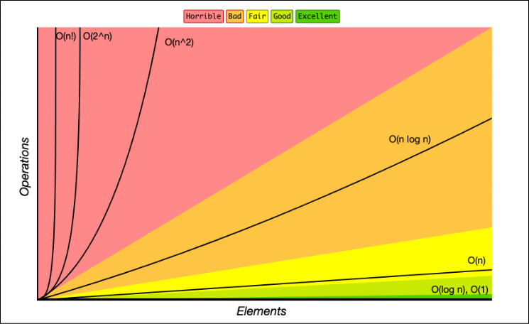
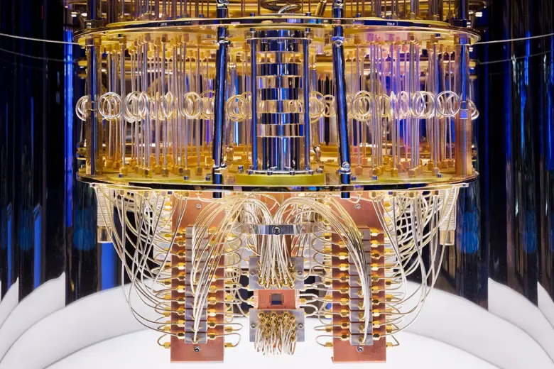
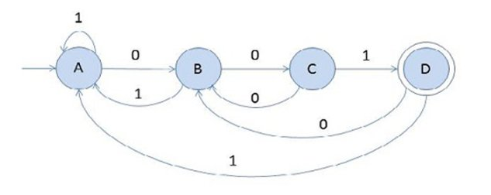
Subfields of Computer Science
Theoretical Computer Science
Automata theory and formal languages
Complexity theory
Quantum computing

Slide 41
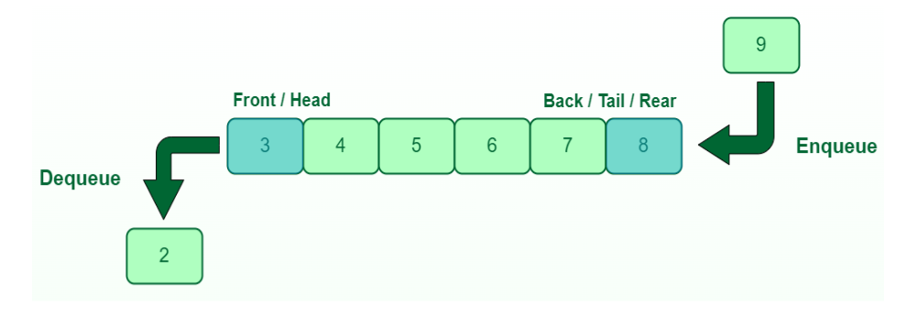

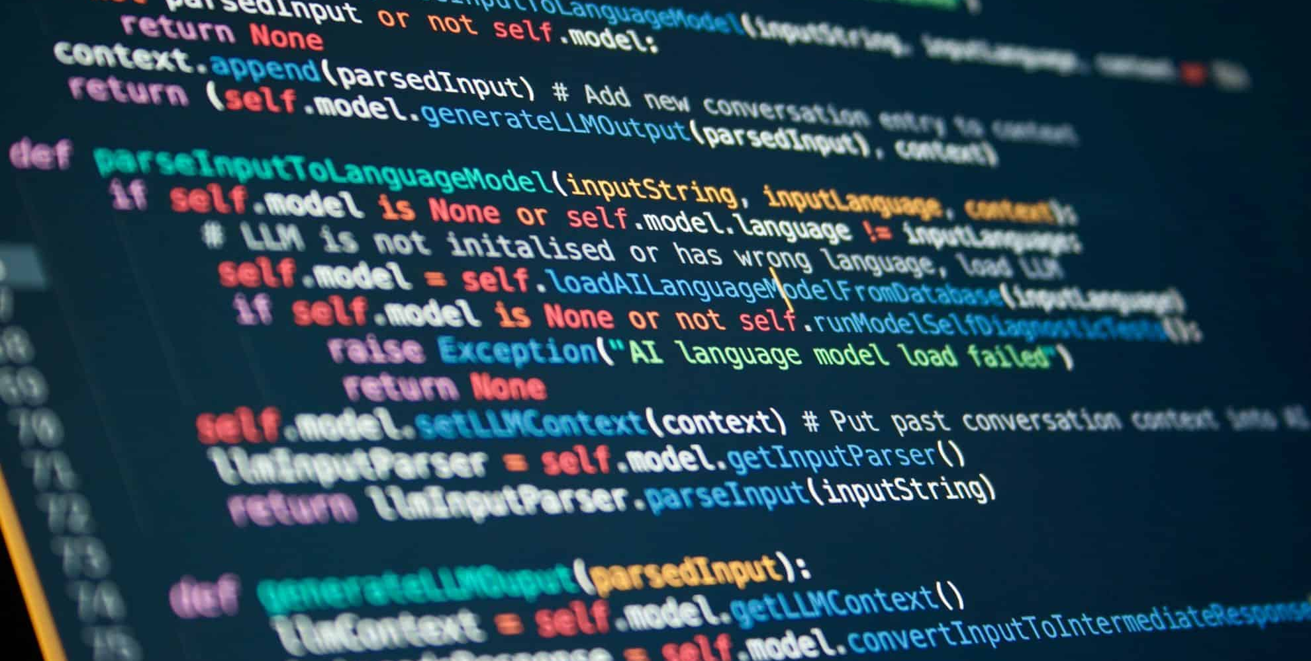
Subfields of Computer Science
Applied Computer Science
Programming languages
Algorithms and data structures
Operating systems
Databases
Software development

Slide 42
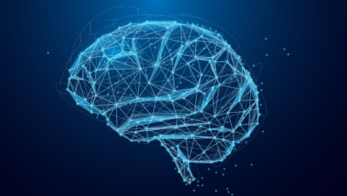

Subfields of Computer Science
Interdisciplinary Fields
Business informatics
Computer vision
Artificial intelligence
Computational linguistics
Bioinformatics
Medical informatics
Media informatics
Human-Computer Interaction (HCI)
Computational Social Science

Slide 43
Subfields of Computer Science
Computer Engineering
Microprocessor technology
Computer architecture
Communication between machines
Interdisciplinary Fields
Business informatics
Computer vision
Artificial intelligence
Computational linguistics
Bioinformatics
Medical informatics
Media informatics
Human-Computer Interaction (HCI)
Computational Social Science
and much more …
Applied Computer Science
Programming languages
Algorithms and data structures
Operating systems
Databases
Software development
Computer Science
Theoretical Computer Science
Automata theory and formal languages
Complexity theory
Quantum computing

Slide 44
Literature
Course Motivations and Objectives
Course Overview
Formalities
A Brief Introduction to Computer Science
Literature

Slide 45
Literature
No one book that covers the content of the course, specific references for each topic provided with each lecture.
Two broader reference books complement the content taught in the lectures
‘Introduction to Computing - Explorations in Language, Logic, and Machines’ by Evans (ISBN: 1-4636-8747-8)
Algorithms Unlocked by Thomas H. Cormen (ISBN: 978-0-262-51880-2)
‘Introduction to Computation and Programming Using Python’ by Guttag (ISBN: 0-2625-2500-3)
Why these books?
Evans and Guttag give introduction to programming that is accessible to students without prior programming background
Evans book places a particular emphasis of the Python programming language used throughout the course. Guttag is based on LISP which is a language we will not use.
Cormen introduces theoretical concepts in CS for a wide audience
For advanced reading on algorithm and data structures: ‘Introduction to Algorithms’ by Cormen, Leiserson, Rivest, and Stein (ISBN: 0-2620-3384-8)

Slide 46
Next Session
Information Coding
Memory
Data Types and Structures
First tutorial: using the terminal and github
Don’t miss it!

